Slide 1
Arduino project
On proteus platform
CSE 316
University of Asia Pacific Department of CSE
Course teacher : Abdullah Al Omar
(Lecturer)

Slide 2
Group Members
1
2
Name : | Niamul Hasan
Id: | 17201026
Semester: | 3.2
Section : | A1
Name : | Md. Anik khan
Id: | 17201021
Semester: | 3.2
Section : | A1

Slide 3
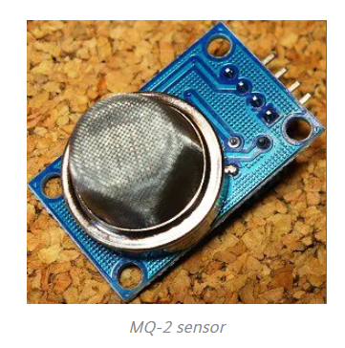
Project Title: Gas Detector Sensor (MQ2)

Slide 4
What is an MQ-2 Smoke Sensor?
LPG
Butane
Propane
Methane
Alcohol
Hydrogen

Slide 5
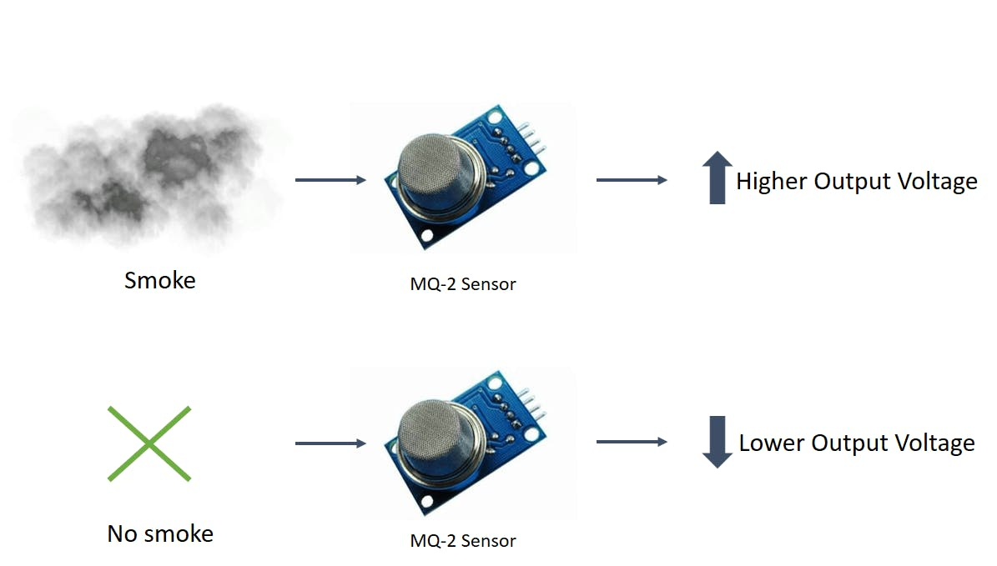
How does it Work?

Slide 6
Equipment for the projects
Arduino UNO
GAS Sensor (MQ2)
Logic Toggle(1 piece)
LEDs (2 piece)
Switch (2 piece)
Resistor (3 piece)
VCC-Power source(1 piece)
GND-Ground(3 piece)
LCD1
Servo motor (1 piece)

Slide 7
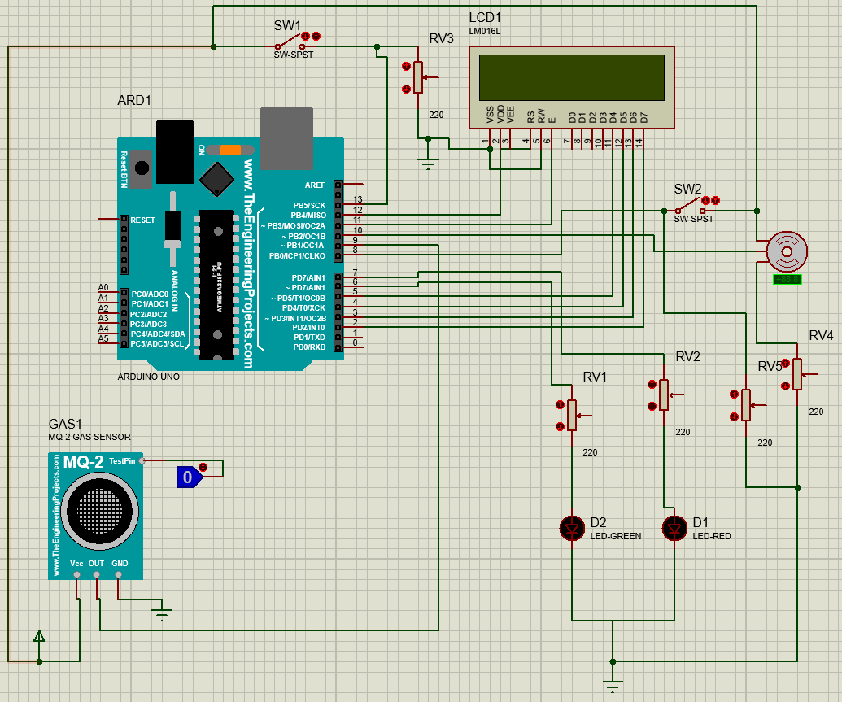
Circuit diagram
Switch

Slide 8

Motivation
4 September , 2020

Slide 9
Conclusion
A simulation of smock detector sensor
Platform limitation
System lacking

Slide 10
Thank You

